Slide 1
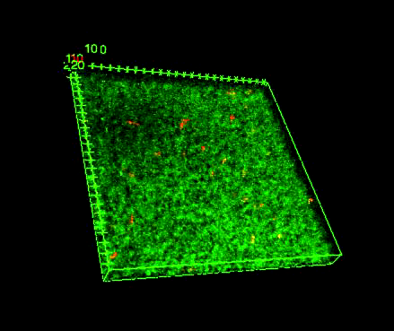
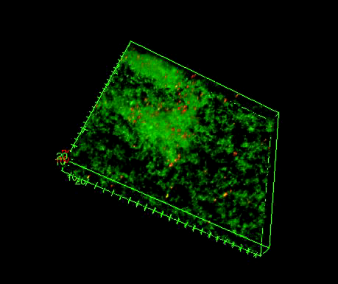
How to use the Bead Evaluator function of the Biofilm Plugin
to characterize the material properties of biofilms
Malhotra* K, Hunter* T, Henry* B, Ishmail Y, Gaddameedi P, Tursi S, Tükel Ç, Hoffer M, Buttaro* BA, Queisser* G. Development of a New Bead Movement-Based Computational Framework Shows that Bacterial Amyloid Curli Reduces Bead Mobility in Biofilms. J Bacteriol. 2020 Aug 25;202(18):e00253-20. doi: 10.1128/JB.00253-20. PMID: 32601073.
Bacterial biofilms can have different material properties from rigid to fluid-like based on the rigidity and viscoelastic properties of the biofilms.
This tool uses bead movement over time to measure the viscoelastic properties of the biofilm
It can be used to compare differences in natural biofilms or biofilms after monoclonal antibody treatment (in collaboration with the Tükel Laboratory).
Time lapse video following bead movement for 20 minutes [played back at 120X (10 sec)] in Enterococcus faecalis OG1RF biofilms (left) and Salmonella enterica serotype Typhimurium (right)

Slide 2
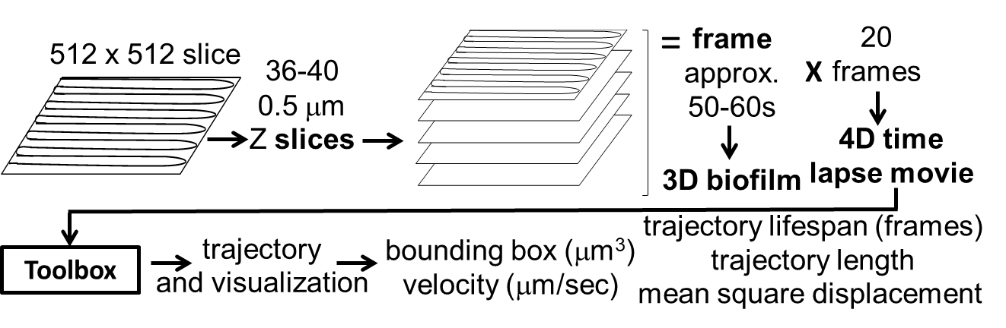
Overview of Confocal Imaging Steps
Add fluorescent beads of desired property (1 micrometer glyoxylate beads in example video). They must have their own laser for excitation for imaging (crimson red).
Beads can be added to the biofilm and non-associated beads can be removed by gentle washing. The best data is derived from 40-140 beads.
The bacteria should be stained or fluorescent (Syto9 in example video).
The biofilm is imaged using laser scanning confocal microscopy
Generate a series of continuous Z-stacks over time (example used continuous imaging of an approximately 20 μm thick section in 0.5 μm sections at a resolution of 512x512 for 20 stacks (see material and methods).
Save .lif file
Trajectory lifespan
(frames)

Slide 3
Overview of Analysis Steps 071718
Open .lif file in ImageJ
Image -> color -> split channels
Save files separately Save as -> tiff [name bacteria and beads]
Go to Plugins/Mosaic and select Particle tracker 2D/3D
Input parameters (example Radius: 3, Cutoff: 0.003, Per/Abs: 0.12, Link Range: 2, Displacement: 10.00, dynamics set at Brownian) -> OK
After tracker is completed select “all trajectories to table” and “save as”
Images -> Properties make note of pixel width, height, and voxel depth (four decimals) and frame interval (example 0.4815, 0.4815, and 0.5035 microns and 54 sec)
Launch Bead Evaluator tool [you will need to download VRL Studio and Bead Evaluator Tool]
Import Data Window -> load trajectory under CSV File by press on “…” and selecting file location
Process Trajectories Window enter x, y, and z pixel size found under image properties above
Compute Velocity Window enter frame interval in seconds found under image properties above
Comdensity Window press “…” to choose bacterial .tiff file
Save Velocity Data to File select location to save by pressing “…” IMPORTANT add .csv to file name
Save Trajectory Data to File select location to save by pressing “…” IMPORTANT add .csv to file name
Invoke each step
Saved csv files can be opened in excel and will contain trajectory lengths, lifespans, bounding boxes (dimensions and volumes), velocities and variances, weighted variables calculating density using Syto9 intensity.

